Slide 1
Access to College Credits for
ALL Students
Increasing opportunities for our students on the WHS Campus

Slide 2
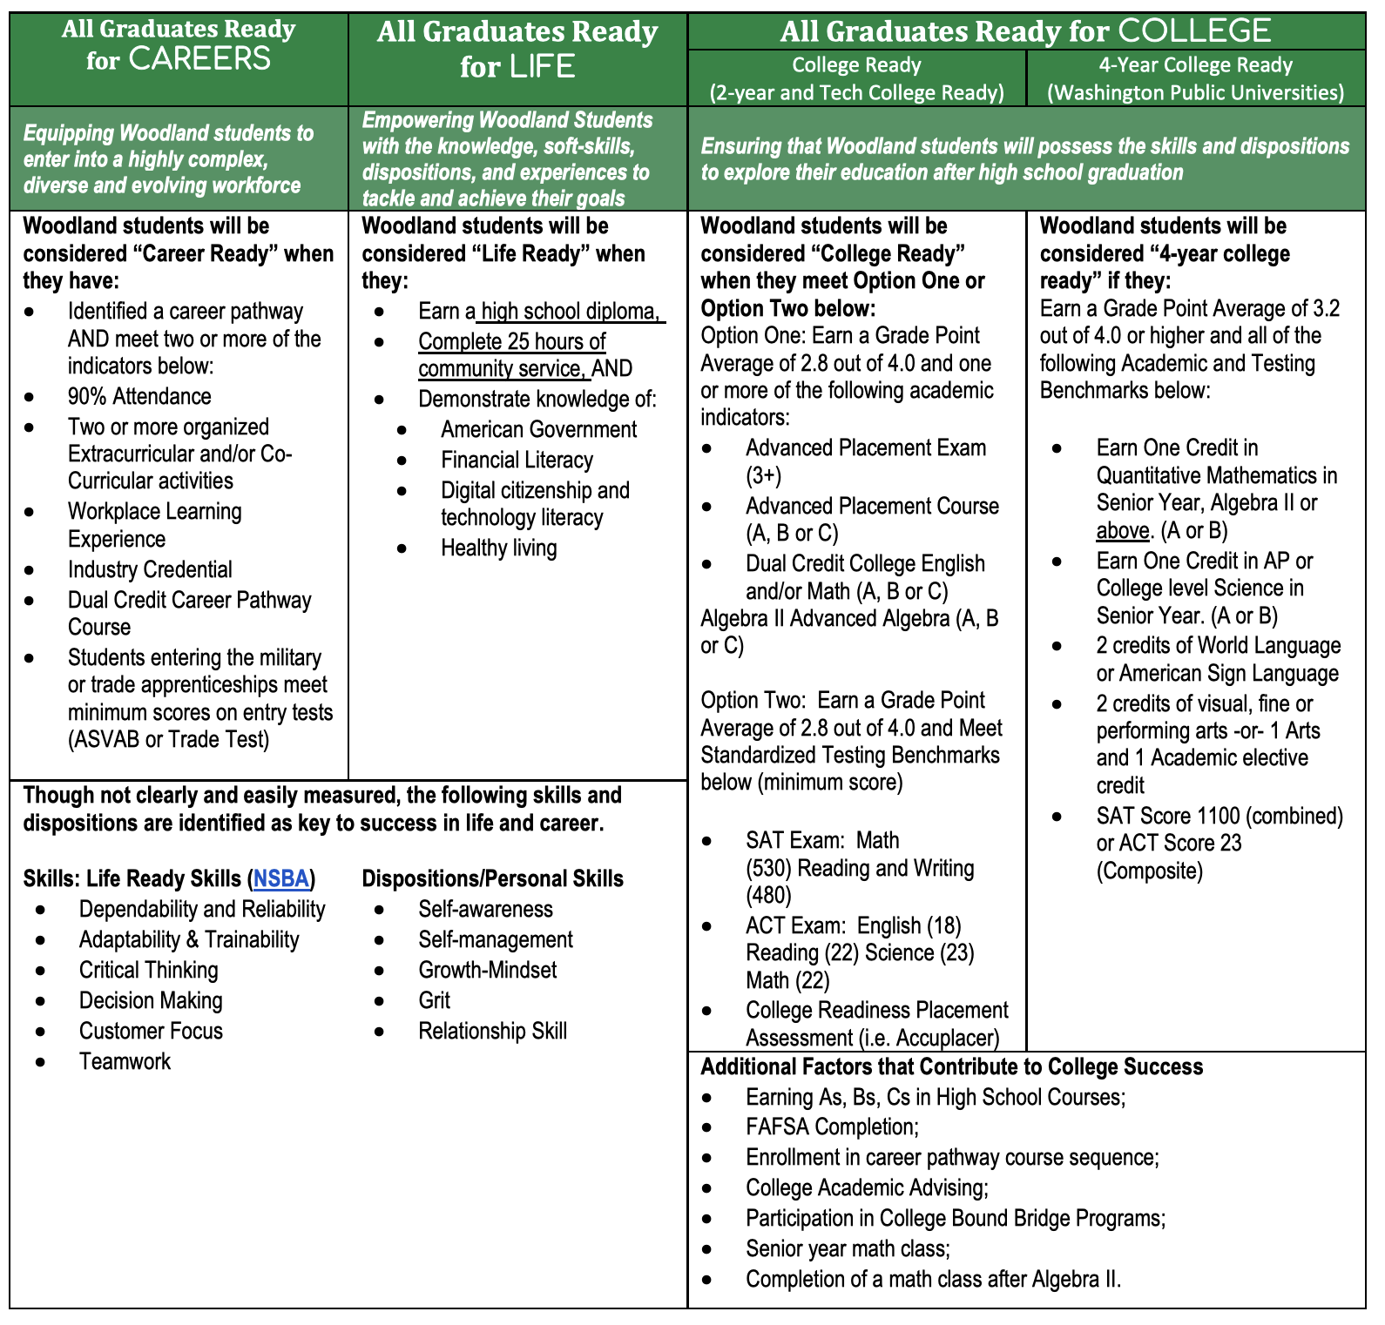

Slide 3
“Career and College Ready”
Ensuring that Woodland students will possess the skills and dispositions to explore post-high school graduation education.
Woodland students will be considered “College Ready” when they earn a Grade Point Average of 2.8 out of 4.0 and one or more of the following academic indicators:
Advanced Placement Exam (3+)
Advanced Placement Course (A, B or C)
Dual Credit College English and/or Math (A, B or C)
Algebra II Advanced Algebra (A, B or C)

Slide 4
Current Opportunities
Running Start | Students leave Woodland High School and join a community college campus (LCC or Clark) to earn college credit. | 11th and 12th Grade Students | 51 Full Time Students 35 Part Time Students
College in the High School Dual Credit | Students accessing college credit and high school credit in select (limited) classes provided at WHS. | 10th-12th Grade Students | 31 Students
Career and Technical Education Dual Credit | Students accessing college credit and high school credit in approved CTE classes provided at WHS. | 9th-12th Grade Students | 220 Students

Slide 5
A NEW Opportunity
Provide opportunities for students to achieve more college credits on the Woodland High School campus
Ensure maximum number of CTE courses offer Dual Credit
Increase opportunities for more students to achieve college credits by removing barriers

Slide 6
Increase access to college courses for ALL Woodland High School students
Ensure ALL CTE courses offer dual college credit AND students know the career pathway beyond high school graduation
Bring more college credits to WHS campus
Remove the travel barrier of Running Start
Increase access to valuable courses (no capacity limit)
Increase success with support of WHS teachers

Slide 7
Arizona State University
“Arizona State University is and will always be a university that measures itself by whom it includes and how they succeed. And during these challenging times, we remain strongly committed to supporting the communities we serve through educational access and student success.”

Slide 8
ASU Prep Digital
ASU Prep Digital:
An accredited online school where you can take a single online course or enroll in a full-time, diploma-granting program. Because we are part of Arizona State University, we offer an accelerated path toward college admission and the chance to earn concurrent high school and university credit.
OPEN SCALE ASU ONLINE COLLEGE COURSES:
Open Scale Courses are a selection of popular first-year college courses available online. Through Open Scale Courses, high school students can test the college waters and begin making progress towards a college degree, in a low risk financial model.

